Slide 1
Cross Addiction: The Effects of Binge Eating Disorder on Weight Loss Surgery Outcome
Katie Polsky, Ph.D.
Clinical Director, New Dawn Eating Disorder Recovery Centers

Slide 2
In the United States…
5 - 10% of girls/women (5 - 10 Million)
1% of boys/men (1 Million)
Source: National Eating Disorder Association (NEDA)

Slide 3
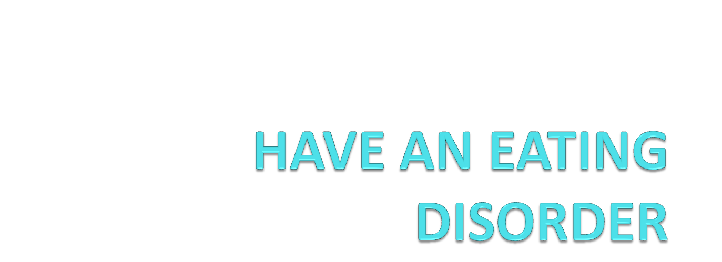

Slide 4






What is an Eating Disorder?

Slide 5
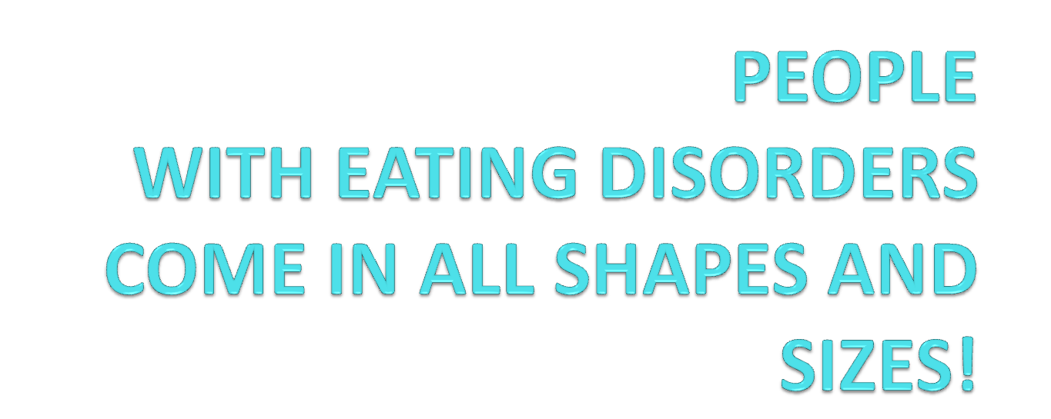

Slide 6
Anorexia Nervosa
Weight at or below 85% of ideal for age and height
Intense fear of gaining weight
Disturbed body image
Amenorrhea
Subtypes:
Restricting Type Binge/Purge Type

Slide 7
Bulimia Nervosa
Binge eating
Compensatory behavior (on average 2 times per week for 3 months)
Disturbed body image
Subtypes:
Purging Type Non-purging Type

Slide 8
Binge Eating Disorder (BED)
  Recurrent episodes of binge eating - includes large amount & sense of “lack of control”
  No compensatory behavior following a binge
  Associated with 3 or more of following:
    Rapid eating
    Eating large amounts of food when not hungry
    Eating until uncomfortably full
    Eating alone/embarrassment
    Guilt/disgust after overeating
  Minimum of 2 times per week for 6 months

Slide 9
Prevalence Rates by Subtype
0.5% - 3.7% of females suffer from Anorexia Nervosa in their lifetime
1.1% - 4.2% of females suffer from Bulimia Nervosa in their lifetime
2% - 5% of the American population experience Binge Eating Disorder
Source: National Eating Disorder Association

Slide 10
Eating Disorder Statistics….
Mortality
  Death rate is 12x greater than the general death rate for women aged 15-24 years
  27% of the deaths associated with eating disorders come from suicide
  Mortality at 5 years is 5% and at 20 years it is 20%
  Long term health complications can lead to premature death later in life

Slide 11
Relative to other conditions…
Individuals with Eating Disorders are estimated to be TRIPLE those living with AIDS
Eating Disorders affect THREE TIMES as many people as schizophrenia
Eating Disorders have the HIGHEST mortality rate of any mental illness - 10% of people with an eating disorder die

Slide 12
Age of Onset
10% report onset at 10 years or younger
33% report onset between ages of 11-15
43% report onset between ages of 16-20
86% report onset of illness by the age of 20

Slide 13
42% of 1st- 3rd grade girls want to be “thinner”
81% of 10 year olds are “afraid” of being “fat”
51% of 9/10 year old girls “feel better” about themselves if they are on a “diet”
46% of 9 - 11 year olds are “sometimes/very often” on diets - as are 82% of their families
Source: Association of Anorexia Nervosa & Associated Disorders

Slide 14
Eating Disorders are Biopsychosocial
Diseases

Slide 15
Causation/Factors
Genetics
-Depression
-OCD
-Anxiety
-Neurotransmitters (Serotonin and Dopamine implicated)
Personality Traits
-Perfectionist
-People pleaser
-Emotionally reserved
-Poor coping skills
-Avoids risks
-Difficulty adapting to change
-Low self-esteem
Trauma/Loss
Family Dynamics
-Expectations
-Stress
Culture
-Thin as the ideal
-Media influence
-Dieting

Slide 16


Slide 17
Psychological Disorders/Problems Associated with BED
Trauma/PTSD
Depression/Mood Disorder
Anxiety
Obsessive Compulsive Disorder

Slide 18
Personality or other characteristics
Difficulty expressing feelings and needs
Need to be in “control”
Avoids conflict, “tries to keep the peace”
Social Isolation
Feelings of worthlessness
Impulsivity
Inability to delay gratification
Struggles with difficult emotions such as anger and sadness
Rigid black or white thinking
Teased about appearance

Slide 19
Sociocultural

Slide 20




Slide 21


Slide 22


Slide 23



Slide 24


Slide 25
Sociocultural
Women who viewed fashion magazines for 1 hour reported increased levels of depression and negative body image
Negative body image has been found to be a precursor to eating disorder behavior

Slide 26
Sociocultural
Thin ideal--DIETING
“Normative Discontent”
Happiness
Emotions
Relationships
Wealth and Fame
We live in an environment that encourages and supports eating disorders and disordered eating

Slide 27


Slide 28
Binge Eating Disorder (BED) Rates Before and After Surgery
  Before Surgery
Up to 64% engage in binge eating
Up to 49% have BED
  After Surgery
Up to 71% engage in binge eating
Up to 32% have BED
Mitchell and Steffen (2009)—Meta-analytic study
University of North Dakota School of Medicine, Fargo

Slide 29
BED and Weight Loss Surgery Outcomes
Those that have BED prior to the surgery lose less weight and regain more, more quickly than those individuals who do not have BED.
Those that have BED with histories of psychiatric illness including depression, anxiety, PTSD, OCD, and substance abuse problems (particularly alcoholism) have poorer prognoses after the surgery.

Slide 30
Risks of Eating Disorder Diagnosis Before Surgery
Poor outcome of surgery or not sustaining weight loss
Dangerous medical complications
Loss of identity
Increased Depression, Anxiety, PTSD symptoms
Bulimia Nervosa
Substance Abuse
Gambling
Sex Addiction
Compulsive Spending
____Addiction

Slide 31
Why is this important?
If the underlying reasons (causes) people develop __________addiction (i.e., BED) are not examined and worked through or dealt with then CROSS ADDICTION or SYMPTOM SUBSTITUTION WILL OCCUR.
Weight loss surgery is not appropriate or implicated for everyone who wants to or needs to lose weight.

Slide 32
What should you do?
Examine why you eat, drink, do drugs, etc.
Seek therapy around your addiction. Chances are there are environmental/social factors (trauma/abuse) that are involved in your addiction as well as biological factors.
There is no quick fix.

Slide 33
CONTACT INFORMATION
For an eating disorder assessment, please call New Dawn Eating Disorder Recovery Centers at:
415-331-1383
www.newdawnrecovery.com
info@newdawnrecovery.com
For local outpatient referrals, you can call Katie Polsky, Ph.D. (916)284-1416 or email at drpolsky@gmail.com

